Slide 1
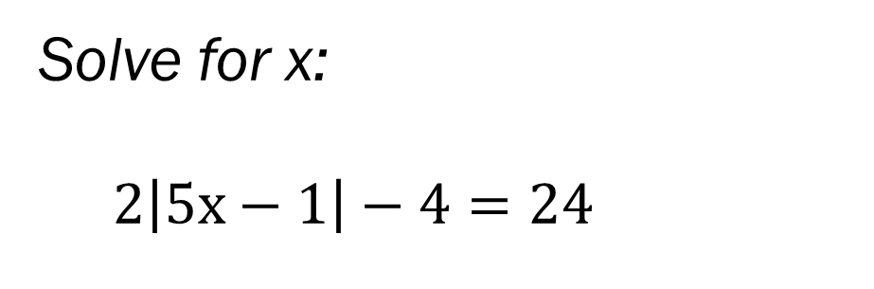
Bell Work (10 – 12 minutes)
Solve for x:
$2\left|5x−1\right|−4=24$
What is the slope? And how far apart are these 2 points:
(5, -2) and (-7, 3)
Note: these 2 problems will help on quiz today – I took forever to color coat the answers… so please try to understand them ☺

Slide 2
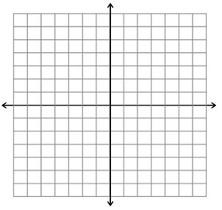

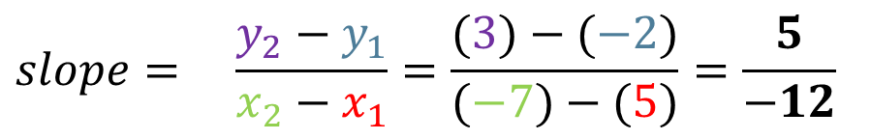

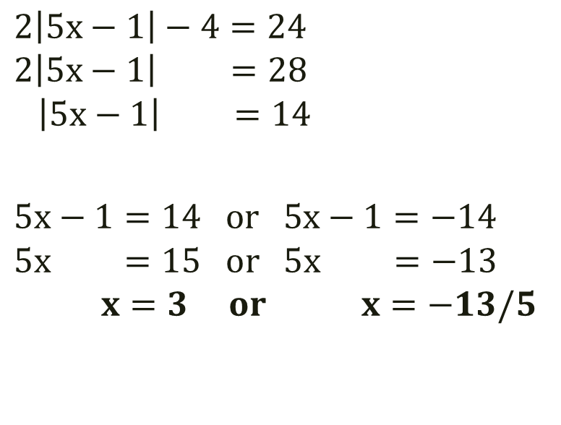




Bell Work Answers:
$${ (x}_{1},y_{1}) and{(x}_{2},y_{2})$$
(5, --2) and (-7, 3)
$$2\left|5x−1\right|−4=24$$
$$2\left|5x−1\right| =28$$
$$\left|5x−1\right| =14$$
$$5x−1=14 or 5x−1=−14$$
$$5x =15 or 5x =−13$$
$$x=3 or x=−13/5$$
$$slope= \frac{y_{2}−y_{1}}{x_{2}−x_{1}}=\frac{(3)−(−2)}{(−7)−(5)}=\frac{5}{−12}$$
We can use Pythagorean
Theorem to find how far
Apart the two dots are
(the red line on the graph)
$$a^{2}+b^{2}=c^{2}$$
5
$$5^{2}+{12}^{2}=c^{2}$$
12
$$25+144=c^{2}$$
$$169=c^{2}→c=13$$
$$=13→the dots are 13 units apart$$

Slide 3
From last time… (12– 15 minutes)
New Material
Page 78 #4-6, 23, 31, 37, 50
Mixed Review
Page 80 #68, 69, 71

Slide 4
ALGEBRA 3

Slide 5
Review for Quiz (5 – 8 minutes) Organize your notes, work through last minute problems with a partner or group before the quiz (bell work, old homework, etc)
Level 2
Solve Inequalities (hint: only flip sign if multiply or divide by negative)
Solve Absolute Value (hint: should get 2 answers if x inside |x| symbols)
Solve Inequality Absolute Value (hint: apply both hints above)
Level 3
Write the Equation of a Line through 2 points (hint: formula from last time)
Find the distance between 2 points (hint: bell work from today!)
Level 4
Set up and solve a problem

Slide 6

Algebra 3 Quiz 2 (12 – 15 minutes on this slide) Level 2:
Solve for x, if possible.
$$1.) 2x−9+4≥3x+8$$
Solve for t, if possible.
$$2.) 20=\left|7t+1\right|+5$$
Solve for w, if possible.
$$3.) 2\left|w−3\right|+1<21$$

Slide 7
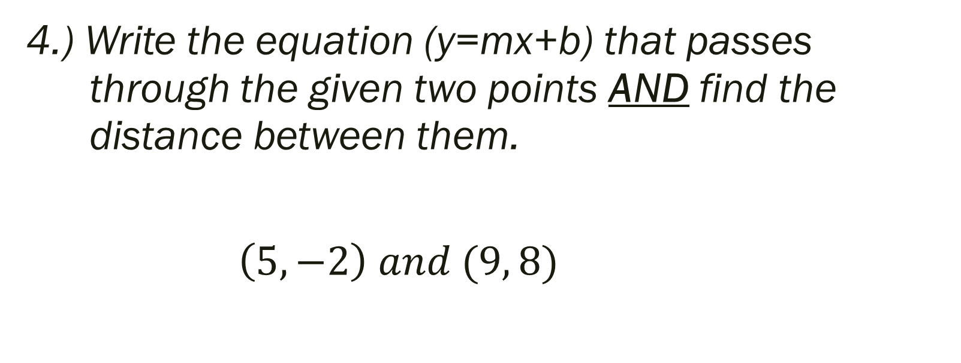
Algebra 3 Quiz 2 (6 – 8 minutes on this slide) Level 3:
4.) Write the equation (y=mx+b) that passes through the given two points AND find the distance between them.
$\left(5, −2\right) and (9, 8)$

Slide 8
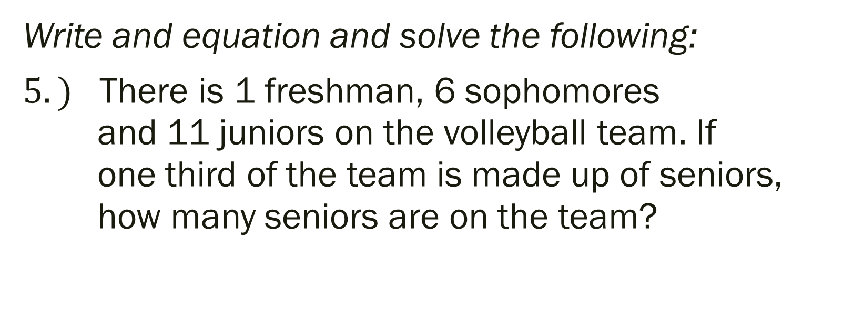
Algebra 3 Quiz 2 (6 – 8 minutes on this slide) Level 4:
Write and equation and solve the following:
$5.)$ There is 1 freshman, 6 sophomores and 11 juniors on the volleyball team. If one third of the team is made up of seniors, how many seniors are on the team?

Slide 9
Things to Study for the Test Copy into notes for studying (5 – 8 minutes)
Solve equations for the indicated variable
Solve inequalities and graph on number line
Solve absolute value
Solve equations with several steps
Solve compound inequalities
Graph a line
Write equation of line and tell how far apart two points are
Write an equation and solve it based on a story problem

Slide 10
Work on old assignments from the board (everything due next class, and/or this Test Review Assignment (Remaining of Time)
Page 51 #14-15, 18-26, 28-34
Page 53 #13, 17
Page 124 #17-25 (odd)

